Slide 1
Anchors

Slide 2
Write words to song here.

Slide 3
Anchors

Slide 4
Review Questions
  What 2 things should you remember when
  it come to evolution?
  Nothing comes from nothing.
  No new genetic information can be added to genetic code
Notes:
The review questions are from the previous lesson. You can either think of these yourself or you can use the “Suggested Review Questions” in the previous lesson notes after the small group discussion questions page.

Slide 5
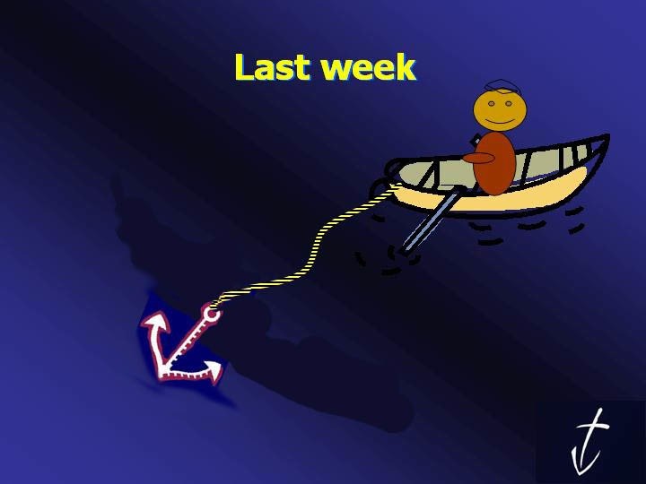
Review of our Anchors

Slide 6


The Christian worldview is the way God views the world.
The god of Islam is not
the same as the God of
the Bible.
God keeps His covenant promise.
Jesus is God.
God is who He says He is.
God created.
Everyone has a worldview.
A Christian
Believes in
Jesus
The Bible
is reliable.
Jesus Christ died and rose
again.

Slide 7
Anchor Of The Week
Satan is real and active in the world

Slide 8
Show Matt Abernathy testimony

Slide 9
Satan
AWH Page 203
Is Satan real?
Ezekial 28:11-19
Isaiah 14:12-20
Genesis 3:1-5

Slide 10
Satan
Where did Satan originate?

Slide 11
AWH Page 204
Names of Satan
Angel of Light
    Christians
    Gospel
    Righteous
    Ministers
    Counterfeit Christs
The Enemy
Destroyer
Adversary
Liar and Murderer
Prince of this World
Prince of the Air
God of this Age
Lawless One
Devil
Blinds Minds
Unclean Spirit
Prince of demons

Slide 12
AWH Page 205
Satan
How does the lie spread?
How can we escape him?
What are Satan’s helpers?
What are Satan’s ploys?
How do we fight Satan?
  1 Peter 2:11
  Ephesians 6:12-15
  1 John 4:4
  Colossians 1:12-14

Slide 13
AWH Page 207
Questions about Satan
Is Satan incapable of doing good in order to deceive?
What is Satan’s prime desire?
Can a Christian be impacted by Satan?

Slide 14
The Bible is
Reliable.
God Created.
Jesus is God.
God keeps His
Covenant promise.
God is who He says He is.
Satan is real and
active in the world.
Jesus died and
Rose again.
Everyone has a worldview.
The god of Islam is not the God of the Bible.
The Christian worldview is
the way God sees the world.
The Christian believes
in Christ and follows Him.

Slide 15
Anchors

