Slide 1
Anchorsaway

Slide 2
AWH Page 61
Anchor Of The Week
The Bible Is Reliable

Slide 3
FOUR DEADLY QUESTIONS
AWH Page 61
#1. What do you mean by that?
#2. How do you know that is true?
#3. Where do you get your information?
#4. What happens if you are wrong?

Slide 4
You can say whatever you want to say about God. It doesn’t matter. All religions are the same.
Christians say that the Bible is the word of God. How do you know that it is true?

Slide 5
F A M I L I A R

Slide 6
Questions Of The Week:
Is the Bible authentic, and is it historically reliable?
Could man, without God, have written the Bible?

Slide 7
What does God say about the Bible?
2 Tim 3:16-17
2 Peter 1:20-21

Slide 8
AWH Page 62
The Uniqueness of the Bible

Slide 9
Pause and show movie clip from Discovering the Bible
Discovering the Bible by the Christian History Institute

Slide 10
THE BIBLE
Discovering the Bible by the Christian History Institute
Notes:
You will find this clip on the Teacher’s Site under Lessons → Lesson 4.

Slide 11
AWH Page 62
One Continuous Theme
The Redemption of Man
The Central Person of the Bible:
The Messiah, the Lord Jesus Christ

Slide 12
The amazing uniqueness of the Bible does not make it true.

Slide 13
Proofs of the Reliability of the Bible...three tests:
Bibliographical Test
Internal Evidence Tests
External Evidence Test

Slide 14
Proof of the Reliability of the Bible Josh McDowell, Evidence that Demands a Verdict
AWH Page 63
Bibliographical Test
The Scribes

Slide 15
SCRIBES
AWH Page 64
Pause and show film clip from Discovering the Bible
Discovering the Bible by the Christian History Institute
Notes:
You will find this clip on the Teacher’s Site under Lessons → Lesson 4.

Slide 16
Proof of the Reliability of the Bible Josh McDowell, Evidence that Demands a Verdict
AWH Page 65
Bibliographical Test
The Scribes
Manuscript Comparisons

Slide 17
Proof of the Reliability of the Bible Josh McDowell, Evidence that Demands a Verdict
Bibliographical Test
The Scribes
Manuscript Comparisons
Internal Evidence Test
Prophecy

Slide 18
Eight Prophecies
AWH Page 66
Born at Bethlehem
Preceded by a messenger
He was to enter Jerusalem on a donkey
Betrayed by a friend
Sold for 30 pieces of silver
Money to be thrown in God’s House
Dumb before accusers
Hands and feet pierced

Slide 19
Probabilities of one man fulfilling all 48 prophecies
AWH Page 68
Scientific threshold for the absurd:
10 to the 50th power
8 Prophecies: one in 10 to the 17th power
Concept Model: State of Texas covered with silver dollars, 2 feet deep.
Number of seconds in the history of the universe.
16 Prophecies: one in 10 to the 45th power
Concept Model: ball of silver dollars: radius 30 times the distance of the Earth to the Sun.
48 Prophecies: one in 10 to the 157th power

Slide 20
Observations
Seconds in 10 billion years: 10¹⁷
Total Atoms in the Universe: 10⁶⁶
Total Particles: 10⁸⁰

Slide 21
Concept Model
NONE
It’s bigger than we can grasp!

Slide 22
Proof of the Reliability of the Bible Josh McDowell, Evidence that Demands a Verdict
AWH Page 71
Bibliographical Test
The Scribes
Manuscript Comparisons
Internal Evidence Test
Prophecy
Archaeology

Slide 23
The Museum of the Bible
Washington, DC

Slide 25
The Dead Sea Scrolls
Pause and show movie clip from Discovering the Bible.
Discovering the Bible by the Christian History Institute
Notes:
You will find this clip on the Teacher’s Site under Lessons → Lesson 4.

Slide 26
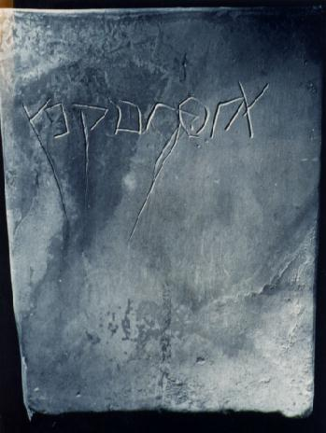
Ossuary of Joseph Caiaphas:
High Priest 18-36 A.D.
(Discovered 1990)

Slide 27
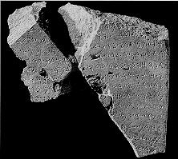
“House of David” 900 B.C.
(Discovered 1993)

Slide 28
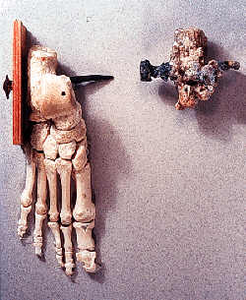
Crucifixion Victim 1st Century A.D. (Discovered in Jerusalem)

Slide 29
Proof of the Reliability of the Bible Josh McDowell, Evidence that Demands a Verdict
AWH Page72
Bibliographical Test
The Scribes
Manuscript Comparisons
Internal Evidence Test
Prophecy
Archaeology
External Evidence Test
Writers

Slide 30
Conclusion
For anyone to fulfill forty-eight biblical prophecies is scientifically absurd, and yet, the Bible reveals that Jesus did just that!
Anyone who rejects Jesus Christ as the son of God is rejecting a fact proven more absolutely than any other fact in the world.

Slide 31
Questions Of The Week:
Is the Bible authentic, and is it historically reliable?
Could man, without God, have written the Bible?

Slide 32
Anchorsaway

